Slide 1

New Offerings 2013
Since Dayton 2012
Rob Sherwood
NCØB
New strides plus some disappointments
Sherwood Engineering
Notes:
Changed font of Ø to 36pt Arial Black.

Slide 2
What is important in a contest or DX pile-up environment is still the same in 2013.
Good Dynamic Range to hear weak signals in the presence of near-by strong signals.
You need a better receiver for CW than for SSB.
There are some new top performers.
Design problems get into production.

Slide 3
What New Rigs have Shipped?
Announced Dayton 2012:
Hilberling PT-8000A @ $18,000
Kenwood TS-990S @ $8,000
Flex 6000 @ $4,300 to $7,500
Yaesu FTdx-3000 @ $2,700
Elecraft KX3 with 100 watt PA option around $1,700

Slide 4
What is unusual about new rigs?
Hilberling may be the last virtually pure analog rig to be designed.
(Also has excellent phase noise, 10-25 dB better than FTdx-5000)
Kenwood TS-990 is 5X the cost of the effective TS-590S
Flex is advertising a very flexible system that is now shipping.
Yaesu 3000 has a disappointing synthesizer compared to 5000
(Significant performance drop at half the price of FTdx-5000)
(Also FTdx-3000 has some serious ergonomic issues)
Elecraft KX3 has phase noise nearly as good as the Hilberling
(Due to direct conversion, close-in CW performance limited)
(KX3 QSK not competitive with K3 QSK)

Slide 5
Are there any Deal Changers this year?
The Hilberling has required many hardware updates after I tested it and used it in two contests.
At $18K+, it will be a niche product.
The 990 vs. 590 leave a significant pricing hole.
Flex 6000 series: is Mouse Control OK for contests?
Yaesu continues to do processing in their ALC.
The advantages of Class A PA are negated by Yaesu ALC design.
Unlikely the KX3 will appeal to serious contesters due to its size.
That said, it worked really well in W1BB CW contest
Notes:
Typo: µV replaces uV.

Slide 6
Details - Hilberling PT-8000A
Covers 160 – 2 meters
16-Pole crystal filters, plus audio DSP
600 watt PA derated to 200 watts; quite clean
Any 2012 production units require major hardware updates
Adding 250 Hz crystal CW filter selection was mandatory for good CW performance
Price is a significant issue
Requires computer for band scope
Notes:
Typo: “an analog meter”

Slide 7
Details – Kenwood TS-990S
Main receiver down conversion all bands
Sub receiver same as TS-590S
50 V. FET PA, excellent transmit IMD
Built-in band scope
CW limitations of 590S-style sub-receiver not present on main receiver for 10, 6 & WARC
Price competitive with competing flagship products of other OEMs
RMDR = 87 dB*. League’s 1-Hz method Dynamic Range = 111 dB. 24 dB difference !
* (20 meters. Varies by band from 85 dB to 98 dB)

Slide 8
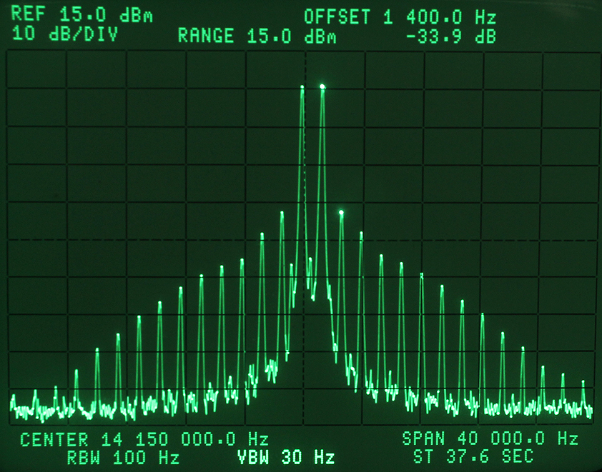
TS-990s Excellent transmit IMD
3rd Order IMD down
34 dB reference test tones
Reference
PEP = IMD down 40 dB
Note: ARRL and OEMs use the PEP method

Slide 9
Details – Flex 6000 series
Fantastic band scope with amazing resolution
Only used a prototype for 2 days in May
Can have multiple receivers and / or bandscopes
Only 1 knob & 3 buttons with external Pod
Needs more mouse sliders for quick settings adj.
Preamp selections seem odd to me.
Handles strong BC signals from 160 antenna well
Have not yet tested 13.8 volt transmit IMD
Why didn’t Flex use a 50 V. PA?

Slide 10
Details – Yaesu FTdx-3000
Ergonomics a significant disappointment
Band scope is close to useless
Adjusting power to drive linear can take 4 or more operations of the menu / buttons / knobs on SSB!
Has typical poor AGC impulse noise problem
Processing is mostly in ALC, same as with the FTdx-5000 and FT-950.
(No point in Class A with Yaesu ALC system)

Slide 11
Details – Elecraft KX3
Amazing tiny radio that performs well
Performed well in Stew Perry CW contest
QSK a big disappointment with lots of clicks on receive audio
Audio level inadequate for 30 ohm phones
Had to use powered computer speakers to drive my Sony headphones
DSP provides good bandwidth control
Needs KXPA100 to drive any linear 1.5 kW
Ergonomics OK for such a small rig

Slide 12
A few more comments on KX3
Limitations for CW are the opposite sideband rejection.
While the 2-kHz dynamic range is excellent, this doesn’t tell the whole story. A signal on the opposite sideband is down only 60 to 70 dB. This is a limitation of direct conversion.
It is possible to have excellent phase noise in a $1000 radio.
Frequency wanders around 5 to 10 Hz due to the LO design. Would be an issue in some weak signal transmission systems such as WSJT.
AGC handles impulse noise well, just like K3

Slide 13
Wide-spaced vs. Narrow-spaced DR3
In 1976 I found that wide roofing filters were a problem. Caused overload in CW pile-up.
20-kHz testing not adequate for DR3
2-kHz DR3 test gave drastically lower values
Better approximated on-air results
From 1975-2001 QST only published 20 kHz
2002 QST added 5 kHz DR3 data
2006 QST added 2 kHz DR3 data
Usually 20 to 30 dB lower than 20 kHz value

Slide 14
What value is adequate?
Close-in DR3 of 75 dB OK on SSB.
Why?
Transmitted splatter 3 kHz away usually worse than the dynamic range of the receiver.
On CW, due to much narrower transmit bandwidth signal, 85 dB or better is a desirable number.

Slide 15
ARRL / Sherwood Testing Compromise
From 1976 through 2006 the ARRL and I tested radios in a 500 Hz bandwidth. Worst case data was published whether a radio was Intermod Dynamic Range Limited (DR3) or Phase Noise limited. (Now called reciprocal mixing dynamic range limited - RMDR *)
Between 2007 – 2011 the League virtually took the effect of synthesizer phase noise out of the picture by making dynamic range measurements with an FFT analyzer and a 1 Hz filter bandwidth.
While this measurement is technically accurate, the data usually had little correlation to how the radio performed on the air. It also eliminated the incentive for the OEMs to improve their synthesizers.
In the Fall of 2011, with the help of Adam Farson, VA7OJ, the League agreed to emphasize Reciprocal Mixing Dynamic Range (RMDR *).
* (As defined by the ARRL, April QST 2012)

Slide 16
New Graphic for RMDR, IC-9100 Review
QST April
2012 P. 54
From a practical stand point, the 77 dB value is the limit on the air, not the 87 dB value.

Slide 17
IC-9100 RMDR Table Data QST 4/2012
In a CW pile-up, the reciprocal mixing limitation is more of an issue (77 dB) than if the QRM was up or down the band 20 kHz (101 dB)

Slide 18
Bob clearly explains importance RMDR
Note how reciprocal mixing relates to the two-tone third order DR figures, especially at 5 and 2 kHz spacing. A single, strong adjacent signal 5 or 2 kHz from the desired signal with resulting reciprocal mixing has a greater impact on your ability to hear a desired weak signal than do two strong signals 5 and 10 kHz away (5 kHz spacing) or 2 and 4 kHz away (2 kHz spacing) with a resulting intermodulation distortion (IMD) product that covers up the desired signal. In many cases, reciprocal mixing dynamic range is the primary limiting factor of a receiver’s performance.
-Bob Allison, WB1GCM, ARRL Laboratory Engineer

Slide 19
Elecraft KX3 December QST 2012
For some reason, the next HF transceiver review lost the RMDR graphic, but the reciprocal mixing data was published.
Third order dynamic range at 5 kHz, QST = 103 dB
Note: Phase noise is 16 dB better than the third order dynamic range.
This is the best phase noise ever published in QST for an amateur transceiver !

Slide 20
FTdx-3000 QST Review April 2013
Concerns:
The RMDR Graphic is missing again.
The table data is there, but not emphasized
Third-Order Dyanmic Range with 1 Hz testing method = 100 dB @ 2 kHz
RMDR @ 2 kHz = 82 dB !
Not discussed in the review that RMDR is 18 dB worse than the third order value of 100 dB!
The 100 dB number is meaningless on the air.

Slide 21
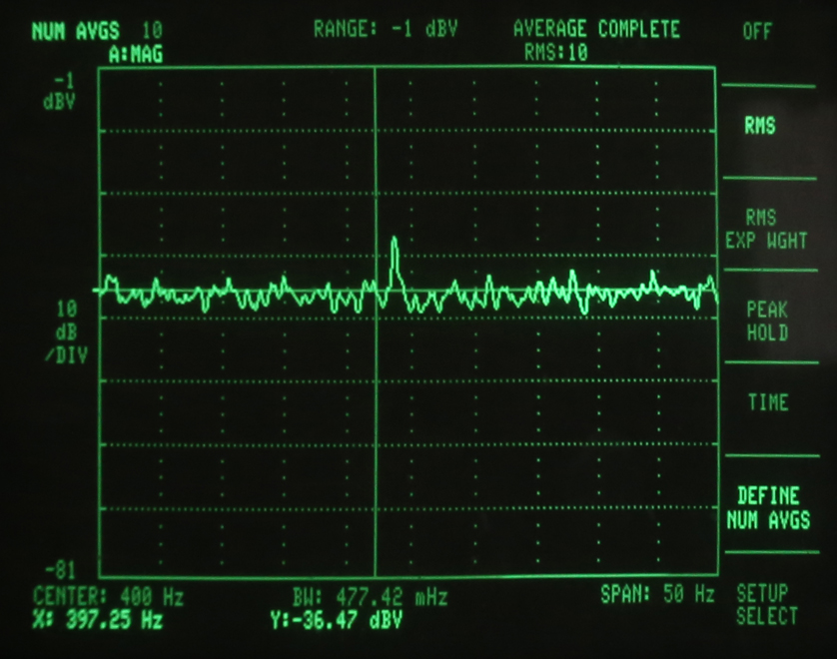
FFT 0.5 Hz BW to measure IMD in 24 dB Noise
Test on TS-990S 20 meters
If 1/1000th the bandwidth of a normal CW filter is needed to measure DR3, what does this prove when we are on the air?

Slide 22
How to sort the wheat from the chaff
The problem for the less technical amateur is how to sort out the data if one is considering advertised or ARRL lab values in making a purchasing choice.
Bob Allison (ARRL Lab Engineer) clearly stated that RMDR is often “the primary limiting factor in receiver performance”.
Since the RMDR graphic in QST was published only once a year ago, this data is easily overlooked.
From Yaesu web site – FTdx-3000:
With frequency separation of only 2 kHz between the desired signal and an interfering signal, the dynamic range measures 106 dB and IP3 +33 dBm.
The 82 dB RMDR value is the real limit, not 106 dB !

Slide 23
Some Amateurs Upset
Many hams have contacted me after buying a radio to say they feel misled.
If published data (magazine ads or ham publications reviews) emphasize performance that is 10 to 25 dB better than on-air performance, we have a problem.
There was a flurry of chatter after I published the FTdx-3000 RMDR of 82 dB Dec 13, 2012.
QST confirms the 82 dB value, but most hams are only seeing the 100 to 106 dB numbers !

Slide 24
E-mail quote from Bob Allison to Rick Stealey, K2XT
“If one is serious about performance, that person will have a very large antenna array on a tall tower. After spending 10's of thousands of dollars on an antenna farm, one would hopefully choose a transceiver with the highest dynamic ranges and would consider each dynamic range carefully.”
“The point is moot with a dipole antenna or even a tribander; there's just not enough voltage at the antenna jack to notice RM or 3 IMD DR.”
This second bullet is NOT TRUE !
Nearby locals can certainly cause RM or DR3 limitations.

Slide 25
Examples of strong signals causing RM & DR3 IMD
Locals, particularly 160 and 80 meters
Dipole at 70 feet 80 m is a cloud warmer !
Field Day, a very difficult environment
Multiple transmitters in Multi-Multi or Milti-2
Multiplier station in a contest
DXpedition with more than one transmitter
East Coast short skip on low bands
A tri-band yagi at ½ wave height will pickup state side signals stronger than a tall stack !

Slide 26
How do we chose a new transceiver?
We should look at lab data, but the numbers can be misleading.
It is a numbers game today!
Evaluation in contest conditions is critical.
A lab setup can never approximate CQ WW !
There are many factors that I have discussed at other forums over the past 5 years.

Slide 27
Important factors to consider
Contest Fatigue is made worse by crappy receive audio and poor AGC performance.
Bad ergonomics can drag down your score.
Transmit IMD (splatter) is not improving.
Is speech processor adequate?
Is firmware regularly updated?
Is warranty service done well and quickly?
Is the radio supported with parts and service after it is out of production?
Botton Line: Do you enjoy using your radio?

Slide 28
Examples of problems rarely discussed
It is amazing what gets into production, isn’t even mentioned in reviews, but degrades performance on receive and transmit.
TS-590S has a 80 to 100 watt ALC spike on SSB when set to 50 watts to drive a low-drive linear. (Alpha 87A, 9500, Acom 1500, 2000)
IC-7410 has the same problem that was mentioned in QST that causes splatter and can blow low-drive ceramic tubes.

Slide 29
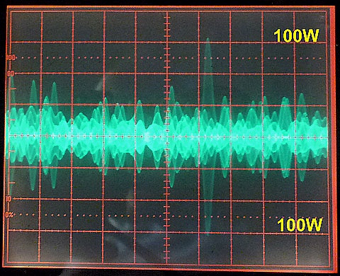
Set to 50 Watts Key Down - White Noise
Courtesy Adam Farson – VA7OJ
IC-7410
6 Div = 100 W PEP. Rig at half power, but spikes to 100 watts every 2 or 3 sec.

Slide 30
Transmit Intermodulation IC-7410
White noise fed into mic jack to approximate speech using IC-7410.
(This is a typical example, not just this rig.)
Look at the “shoulders” of IMD close-in to the transmit passband.
If this station is 3 kHz away and is strong, hearing a weak signal will be difficult.

Slide 31
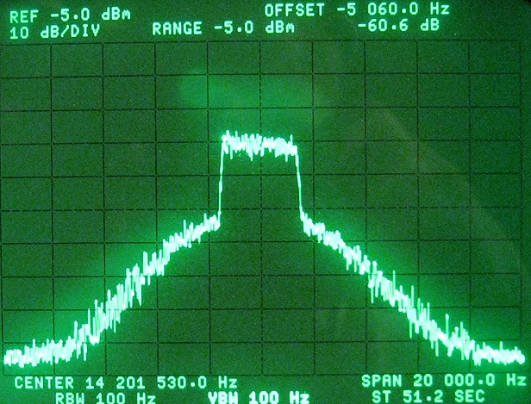
Icom IC-7410 Class AB, White Noise
Noise source = GR 1381, 5-kHz -3 dB BW
5 kHz from edge
60 dB down @ 5 kHz
Notes:
Actually, IC-7410 PA operates in Class AB (180° < conduction angle < 360°)
31

Slide 32
Broad signals Also Exist on CW
The following slide shows the difference between a rise time of 3 milliseconds vs. 10 milliseconds.
There is a 20 dB difference in the strength of the key click 700 Hz removed from the transmitting station.
(Transmitter was a Ten-Tec Omni-VII that has a menu to adjust the rise time.)

Slide 33
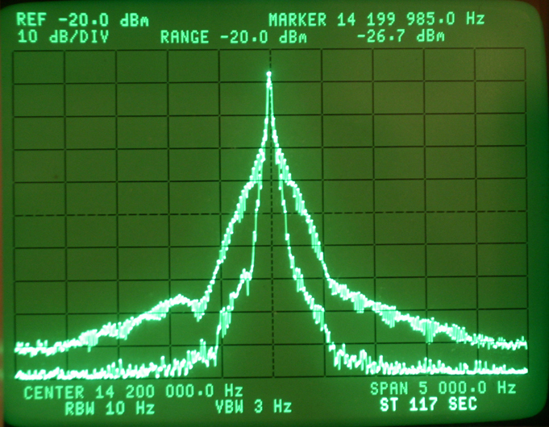
Spectrum of CW Signal on HP 3585A Analyzer
Comparison of 3 msec vs 10 msec rise time
20 dB difference

Slide 34
AGC Impulse Noise Anomaly
Most new radios since 2003 exaggerate impulse noise.
The exceptions: Elecraft, Flex & some newer Ten-Tec
Programmed DSP to ignore a tick, click or pop.
Elecraft calls it the Sherwood Test.

Slide 35
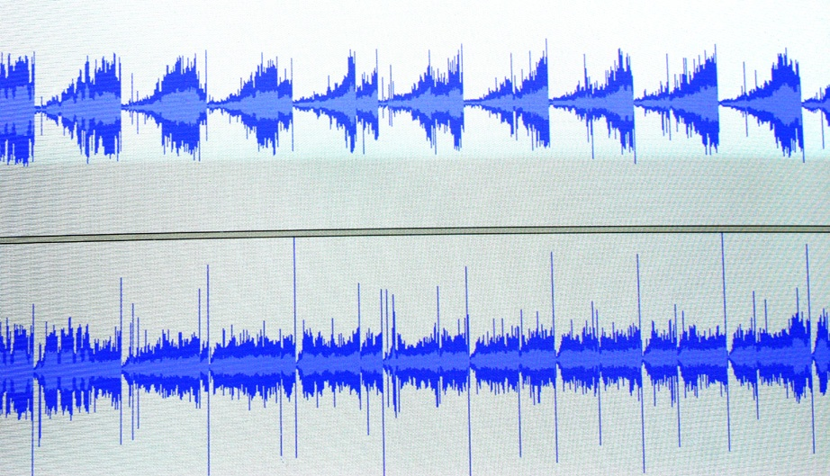
Omni-7 on Top - Pro III on Bottom
CW signal about 15 WPM
Electric Fence firing off every 2 seconds, 160 meters
2 sec

Slide 36

Listen to 30 second audio clip
Audio Icom 756 Pro III
160 meters, 4 PM, Dec 13, 2008
Electric fence & CW signals
KV4FZ calling DX station
Note volume level relatively constant

Slide 37
Audio clip with DSP AGC problem
Audio Ten-Tec Omni-VII
160 meters, 4 PM, Dec 13, 2008
Electric Fence & CW signals
Exact same signals as with Pro III
Note AGC being hammered by impulses
Other rigs with the same AGC problem:
IC-7800, IC-7700, IC-7600 & IC-7000
FTdx-9000, FTdx-5000, FTdx-3000
TS-990S
Orion I & II
Notes:
The DSP-based noise blanker in the newer Icom radios (IC-7600/7700/7800/7410/9100/7200) and in the Perseus SDR effectively mitigates this AGC response to fast-rising RF events by modifying the AGC attack profile. If properly adjusted, the NB will not cause distortion or degrade recovered audio quality.

Slide 38
Contest Fatigue from audio artifacts
In the “good old days”, a pair of 6V6s in push pull were common. Audio was smooth and pleasant.
Often today receive audio is an after thought.
The rig manufacturers need to be concerned about the noise and distortion beyond the 300 to 3000 Hz bandwidth. Our ears hear much more than 2700 Hz of bandwidth.

Slide 39
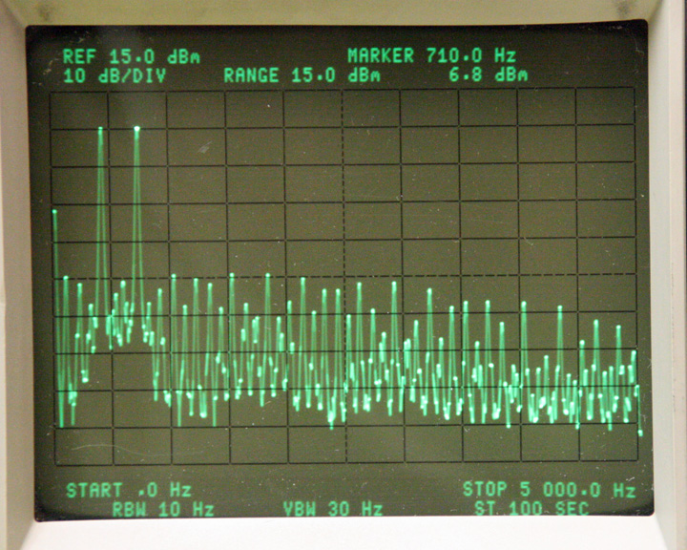
Screen shot from Elecraft Lab Fall 2008
Factory Confirms K3 Audio Problem

Slide 40
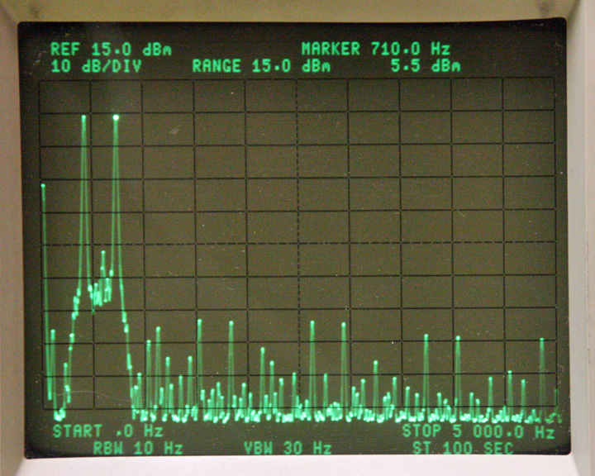
K3 After New Choke Installed
Factory Addresses K3 Audio Problem

Slide 41
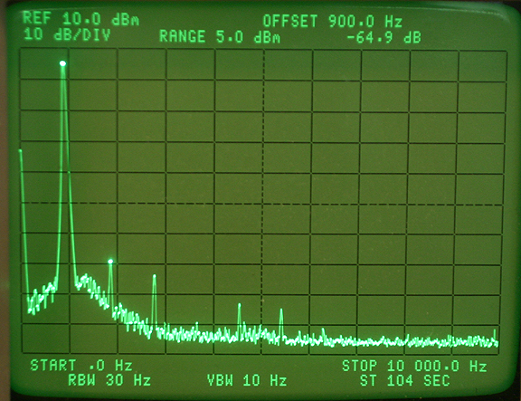
Icom 756 Pro III Harmonic Distortion
0.1 % distortion

Slide 42
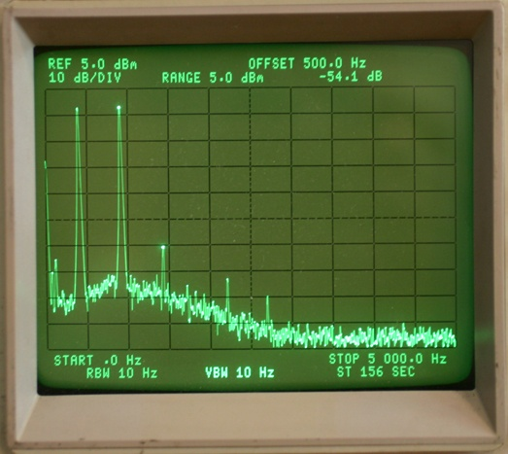
Icom 756 Pro III in-band IMD Distortion
< 0.3 % distortion
-54 dB 3rd Order IMD

Slide 43
Choices today on rig selection
We have rigs from $1000 to $18,000 for sale.
Many do well in contest conditions.
It is hard evaluate on-air performance from some of the published data.
Many aspects of a radio affect contest scores
In the end, hopefully you enjoy using your rig on the air !

Slide 44

Sherwood Engineering
http://www.sherwood-engineering.com
http://www.NC0B.com

